Slide 1
Elimination with Matrices
MATH 4341 : Linear Algebra
Aashnan Rahman
Junior Lecturer
Department of Computer Science and Engineering (CSE)
Islamic University of Technology

Slide 2
How do you solve a system of Linear Equations?
Determinants ??
Cramer’s Rule ?

Slide 3

*We do……but later*

Slide 4
How do you solve a system of Linear Equations?
Process of Elimination

Slide 5

Process of Elimination
Success
Good Matrix
Elimination
Failure
Bad Matrix

Slide 6
Process of Elimination
Good Matrix
Invertible Matrix
Bad Matrix
Non-Invertible / Singular Matrix

Slide 7
Process of Elimination
What to do?
Convert A to U
How to solve?
Backward substitution

Slide 8
Process of Elimination
What is a pivot?
A non-zero element in a matrix that is used during the process of Gaussian elimination (or row reduction) to eliminate other elements in its column.

Slide 9
Process of Elimination
Types of Failure
If the first pivot position is zero.
Temporary Failure
If the last pivot position is zero.
Permanent Failure

Slide 10
Process of Elimination
How to deal with Failures?
Temporary Failure
Exchange Rows
Permanent Failure

Slide 11


Slide 12
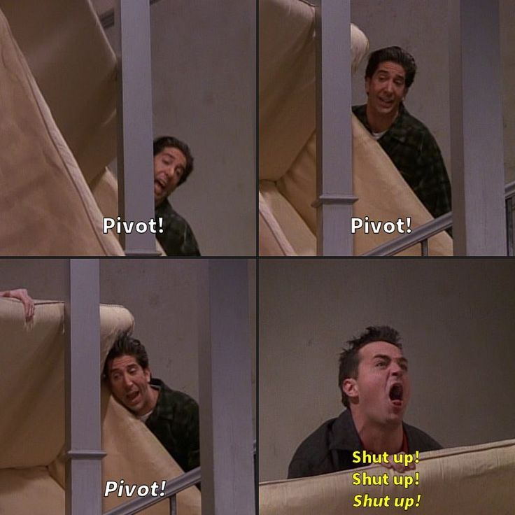
Summary of Today’s Class

Slide 13
—Gilbert Strang
“In fact the idea of Elimination is ……. you would have thought of it, right?
I mean Gauss thought of it before we did
only because he was born earlier.”
“”……And died earlier too”

Slide 14
References
Gilbert Strang (L2)

Slide 15

¡THANKS!

